Slide 1

7023T
Advanced Database Systems
Session 08
Introducing Extract, Transform, Load
This presentation is based on Michael A. Fudge, Jr.

Slide 2
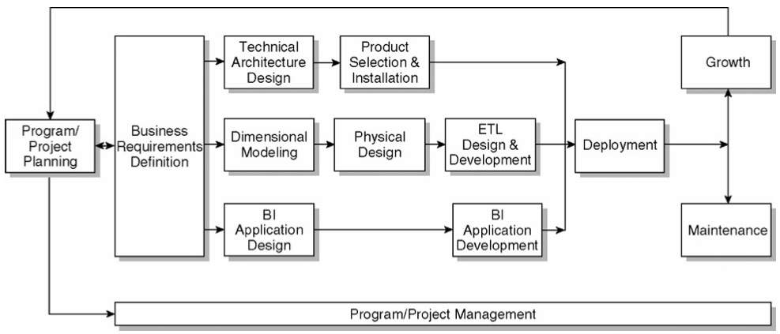
The Kimball Lifecycle Diagram

Slide 3
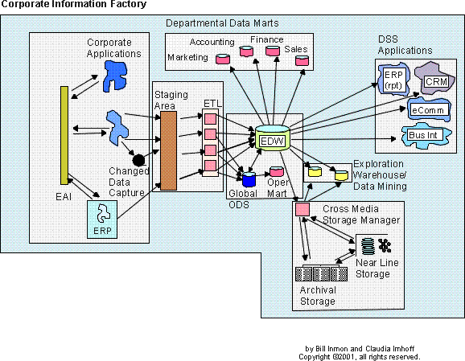
What Exactly is ETL?
ETL or Extract, Transform and Load is a method for populating data into our data warehouse with consistency and reliability.

Slide 4
Kimball: 4 Major ETL Operations
Extract the data from its source
Cleanse and Conform to improve data accuracy and quality (transform)
Deliver the data into the presentation server (load)
Managing the ETL process itself.

Slide 5
ETL Tools
70% of the DW/BI effort is ETL
In the past developers used to program by hand.
ETL tooling is a popular choice today.
All the DBMS vendors offer tools.
Tooling not required but aids the process greatly.
Tooling is visual and self-documenting.
Products
Informatica DI
IBM DataStage
Oracle Data Integrator
SAP Data Services
Microsoft SSIS
Pentaho Kettle

Slide 6
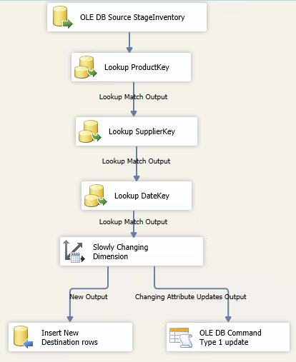
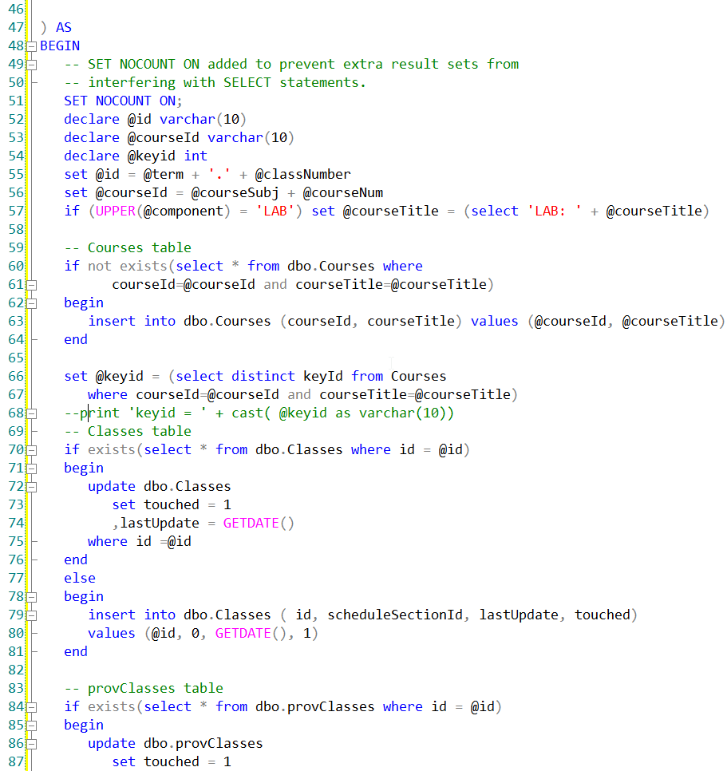
ETL Tool vs. Custom Coding
Which of these is easier to understand?

Slide 7
34 Essential ETL Subsystems
Each one of these systems is part of the E,T,L or Management process

Slide 8
Extracting Data
Subsystems for extracting data.

Slide 9

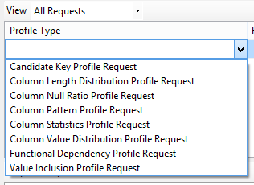
1 – Data Profiling
Helps you to understand the source data.
Identify candidate business keys
Functional dependencies
Nulls
Etc..
Helps us figure out the facts, dimensions, and source-to-target mapping.
Valuable tool when you do not have the SQL chops to query the source data.

Slide 10

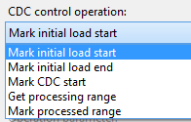
2- Change Data Capture System
A means to detect which data is part of the incremental load (selective processing)
Difficult to get right, needs a lot of testing.
Common Approaches:
Audit columns in source data (last update)
Timed extracts (ex. yesterday’s records)
Diff Compare with CRC / Hash
Database Transactions Logs
Triggers / Message Queues
Notes:
Isolating the latest source data is called change data capture (CDC). The idea behind change data capture is simple enough: Just transfer the data that has been changed since the last load.

Slide 11
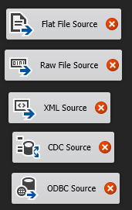
3 – Extract System
Getting data from the source system – a fundamental component!
Two Methods:
File – extracted output from a source system. Useful with 3rd parties / legacy systems.
Stream –initiated data flows out of a system: Middleware query, web service.
Files are useful because they provide restart points without re-querying the source.
Notes:
File: extract to file approach consists of three or four discrete steps: extract to file, move file to ETL
server, transform file contents, and load transformed data into the staging databas
Stream: extract can be constructed so that data flows out of the source system

Slide 12
Let’s think about it?!?!
Assume your data warehousing project requires an extract from a Web API, which delivers data in real time upon request such as the Yahoo Stock Page http://finance.yahoo.com/q;_ylt=AkvD6KtvgA.0gd.aT6SiHxbFgfME?s=AAPL
Explain:
How do you profile this data?
What’s your approach to detecting and capturing changes?
How would you approach data extraction from this source?

Slide 13
Cleaning & Conforming Data
The “T” in ETL

Slide 14
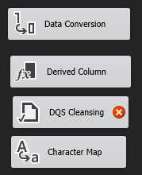
4 – Data Cleansing System
Balance these conflicting goals:
fix dirty data yet maintain data accuracy.
Quality screens act as diagnostic filters:
Column Screens – test data in fields
Structure Screens – test data relationships, lookups (primary/foreign key)
Business Rule Screens – test business logic*
Responding to Quality events:
Fix (ex. Replace NULL w/value)
Log Error and continue or abort (depending on severity)
Notes:
Each quality screen is a test. If the test against the data is successful, nothing happens and the screen has no side effects
*) Example: lifetime platinum frequent flyer has been a member for at least five years and has flown more than two million miles

Slide 15
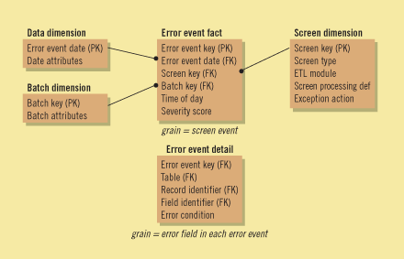
5 – Error Event Schema
A centralized dimensional model for logging errors.
Fact table grain is an error event.
Dimensions are Date, ETL Job, Quality Screen source
A row added whenever there is a quality screening event that results in an error.
Notes:
The error event schema is a centralized dimensional schema whose purpose is to record every error event thrown by a quality screen anywhere in the ETL pipeline

Slide 16
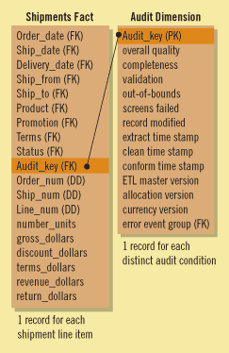
6 – Audit Dimension Assembler
A special dimension, assembled in the back room by the ETL system.
Useful for tracking down how data in your schema “got there” or “was “changed”
Each fact and dimension table uses the audit dimension for recording results of the ETL process.
There are two keys in the audit dimension for original insert and most recent update

Slide 17
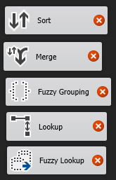
7- Deduplication System
When dimensions are derived from several sources.
Ex. Customer information merges from several lines of business.
Survivorship – the process of combining a set of matched records into unified image of authoritative data.
Master Data Management – centralized facilities to store master copies of data.

Slide 18
8 – Conforming System
Responsible for creating conformed dimensions and facts.
Typically conformed dimensions are managed in one place and distributed as a copy into the required dimensional model.
Sales DM
Marketing DM
Authoritative Dimensions
Finance DM

Slide 19
Let’s think about it?!?!
Suppose our warehouse gathers real-time stock information and from 3 different API’s.
Describe your approach to:
De-duplicate data (same data from different services)
Conform the stock dimension (considering each service might have different attributes)?
Adding quality screens? Which attributes? Which types of screens?

Slide 20
Delivering Data for Presentation
The “L” in ETL

Slide 21

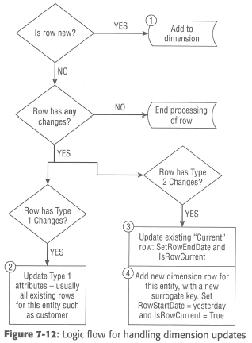
9 – Slowly Changing Dimension Manager
The ETL system must determine how to handle a dimension attribute value that has changed from what is already in the warehouse.

Slide 22
10 – Surrogate Key Manager
Surrogate keys are recommended for PK’s of your dimension tables.
In SQL Server, use IDENTITY
In other DBMS’s use a sequence with a database trigger can be used.
The ETL system can also manage them.

Slide 23
11 – Hierarchy Manager
Hierarchies are common among dimensions. Two Types:
Fixed – a consistent number of levels. Modeled as attributes in the dimension
Example: Product → Manufacturer
Ragged – a variable number of levels. Must be modeled as a snowflake with recursive bridge table.
Example: Outdoors → Camping → Tents → Multi-Room
Master Data Management can help with hierarchies outside the OLTP
Hierarchy Rules are added to the MOLAP Databases

Slide 24
12 – Special Dimensions Manager
A placeholder for supporting an organization’s specific dimensional design characteristics.
Date and/or Time Dimensions
Junk Dimensions
Shrunken Dimensions
Conformed Dimensions which are subsets of a larger dimension.
Small Static Dimensions
Lookup tables not sourced elsewhere
Notes:
Small static dimensions. A few dimensions are created entirely by the ETL system without a real outside source. These are usually small lookup dimensions where an operational code is translated into words

Slide 25
13 – Fact Table Builders
Focuses on the architectural requirements for building the fact tables.
Ensure the referential integrity
Transaction
Loaded as the transaction occurs, or on an interval
Periodic Snapshots
Loaded on an interval based on periods
Accumulating
Since facts are updated the ETL design must accommodate that.

Slide 26

14 – Surrogate Key Pipeline
A system for replacing operational natural keys in the incoming fact table record with appropriate dimension surrogate keys.
Approaches to handling referential integrity errors:
Throw away fact rows – bad idea
Write bad rows to an error table – most common
Insert placeholder row into the dimension – most complex
Fail the package and abort – draconian

Slide 27
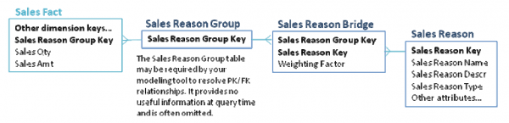
15 – Multi-Valued Dimension Bridge Table Builder
Support for M-M relationships among Fact and Dimensions is required.
Rebalancing the weighted values in the bridge table to add up to 1 is important.
Examples: Patients and diagnoses, Classes and instructors

Slide 28
16 – Late Arriving Data Handler
Ideally we want all data to arrive at the same time.
In some circumstances that is not the case.
Example: Orders are updated daily, but Salesperson changes are processed monthly
The ETL system must handle these situations and still maintain referential integrity.
Placeholder row technique.
Fact assigned a default value for the dimension until it is known. Ex: -2 Customer TBD Once known the dimension value is updated by a separate ETL Task.

Slide 29
17 – Dimension Manager
A Centralized authority, typically a person, who prepares and publishes conformed dimensions to the DW community.
Responsibilities:
Implement descriptive labels for attributes
Add rows to the conformed dimension
Manage attribute changes
Distribute dimensional updates

Slide 30
18 – Fact Provider System
Manage the administration of fact tables
Responsibilities:
Receive duplicated dimensions from the dimension manager
Adds / Updates fact tables
Adjusts / updates stored aggregates which have been invalidated.
Ensure quality of fact data
Notify users of changes, updates, and issues

Slide 31

19 – Aggregate Builder
Aggregates are specific data structures created to improve performance.
Aggregates must be chosen carefully – over aggregation is as problematic as not enough.
Summary Facts and Dimensions are generated from the base facts /dimensions.

Slide 32

20 – OLAP Cube Builder
Cubes (MOLAP) present dimensional data in an intuitive way which is easy to explore.
The ROLAP star schema is the foundation for your MOLAP cube.
Cube must be refreshed when fact and dimension data is added or updated.
Notes:
Pentaho Schema Workbench

Slide 33

21 – Data Propagation Manager
Responsible for moving Warehouse data into other environments for special purposes.
Examples:
Reimbursement programs
Independent auditing
Data mining systems

Slide 34
Let’s think about it?!?!
How would you handle Facts with more than one value in the same Dimension?
How might you manage the surrogate key pipeline for a dimension with no obvious natural key?
Describe your approach to writing a fact record when one of the dimensions is unknown?

Slide 35
Managing the ETL Environment
The last piece of the puzzle, these components help manage the ETL process.

Slide 36
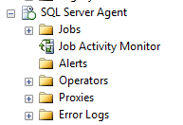
22 – Job Scheduler
As the name implies, the job scheduler is responsible for:
Job Definition
Job Scheduling – when the job runs
Metadata capture – which steps are you on, etc…
Logging
Notification

Slide 37
23 – Backup System
A means to backup, archive and retrieve elements of the ETL system.

Slide 38
24 – Recovery & Restart System
Jobs must be designed to recover from system errors and have the capability to automatically restart, if desired.

Slide 39
25 – Version Control System
Versioning should be part of the ETL process.
ETL is a form of programming and should be placed in a source code management system. (SCM)
Products
GIT
Mercurial
SVN
Check in
ETL Tooling code
SQL
Scripts to run Jobs

Slide 40
26 – Version Migration System
There needs to be a means to transfer changes between environments like Development, Test and production.
Test
Prod
Dev

Slide 41
27 – Workflow Monitor
There must be a system to monitor the ETL processes are operating efficiently and promptly.
There should be:
An audit system
ETL logs
Database monitoring

Slide 42

28 – Sorting System
Sorting is a transformation within the data flow.
Is it typically a final step in loading process when applicable.
A common feature in ETL tooling.

Slide 43
29 – Lineage and Dependency Analyzer
Lineage – the ability to look at a data element and see how it was populated.
Audit Tables help here
Dependency – is opposite direction. Look at a source table and identify the Cubes and star schemas which use it.
Custom Metadata tables

Slide 44
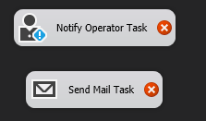
30 – Problem Escalation System
ETL should be automated, but when major issues occur be a system in place to alert administrators.
Minor errors should simply be logged and notified at their typical levels.

Slide 45
31 – Parallelizing / Pipelining System
Take advantage of multiple processors or computers in order to complete the ETL in a timely fashion.
Pentaho Kettle and SSIS supports this feature.

Slide 46
32 – Security System
Since it is not a user-facing system, there should be limited access to the ETL back-end.
Staging tables should be off-limits to business users.

Slide 47
33 – Compliance Manager
A means of maintaining the chain of custody for the data in order to support compliance requirements of regulated environments.

Slide 48
34 – Metadata Repository Manager
A system to manage the metadata associated with the ETL process.

Slide 49
Let’s think about it?!?!
If your ETL tooling does not support Compliance or Metadata Management describe a simple solution you might devise to support these operations.
Could you use the same approach to track lineage? Or a different approach?

